Slide 1
Junior CCC Prep – J4
By Hussain M

Slide 2
What We Will Learn
Converting input string to array
Working with chars
Searching Arrays
Substrings
Shuffling around characters in strings

Slide 3
Substrings
Substring(int beginIndex, int endIndex) method returns portion of string depending on starting and ending indexes
String does not include ending index element
Relates to “char” variable type
Strings are made up of characters
They can be broken up into characters which are variables of type ‘char’

Slide 4
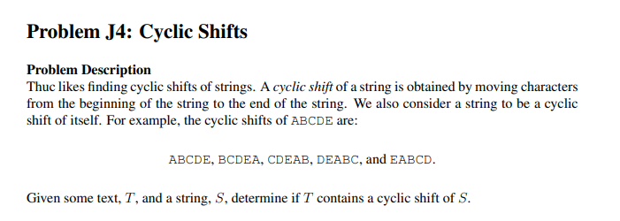
Example J4 Problem: Cyclic Shifts

Slide 5
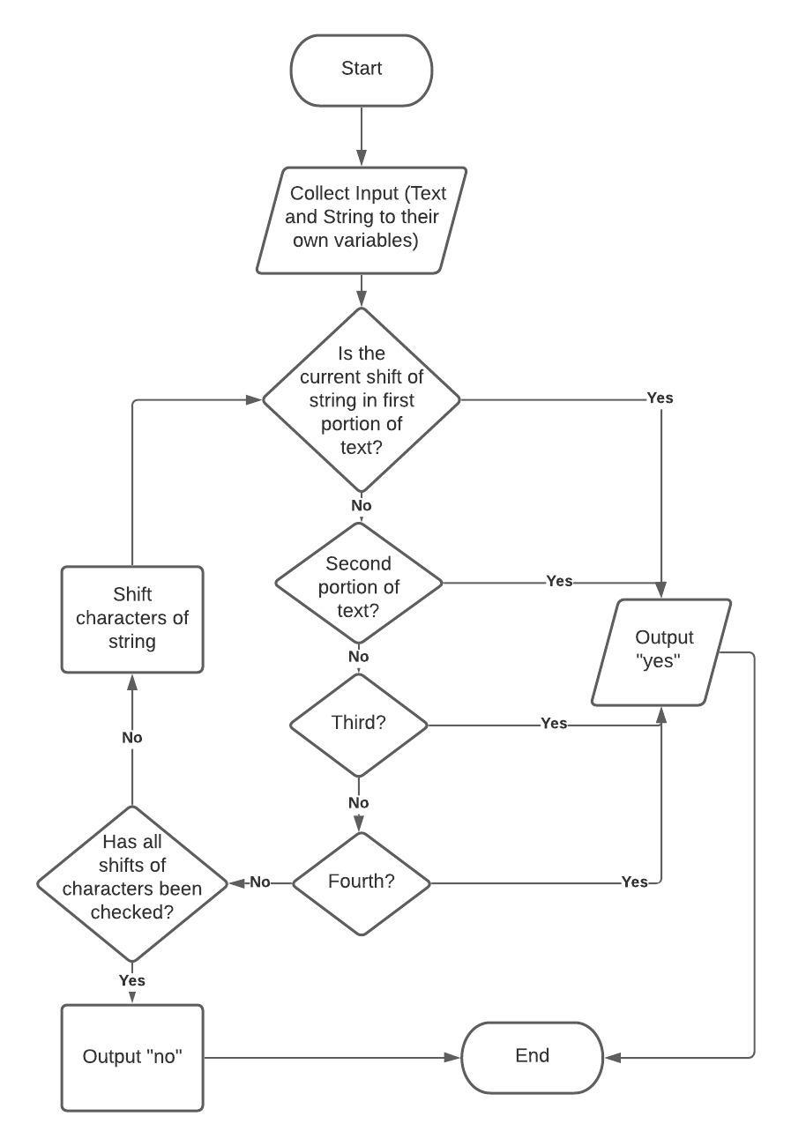
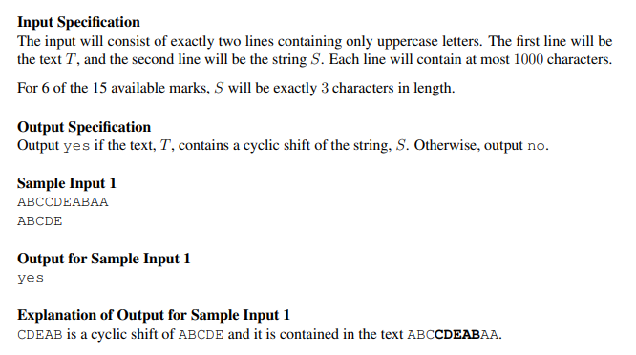
Understanding The Problem

Slide 6
Sub Problems
Collect input
What type of variables will they need to be?
Check if current string is in text
Output “yes” if so and end loop
Remember to check each portion
Shuffle string and loop back to step 2
Output (“yes” or “no”)

Slide 7
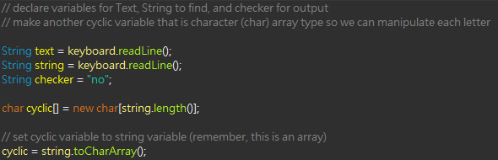

1) Collect Input
Use buffered reader to collect input
Remember to import java.io, add “throws IOException” and initiate with:
Declare variables for…
Text: “text”
String
2 variables; one for comparing: “string”
and another for shuffling: “cyclic”
Output: “checker”
Initialize as no

Slide 8
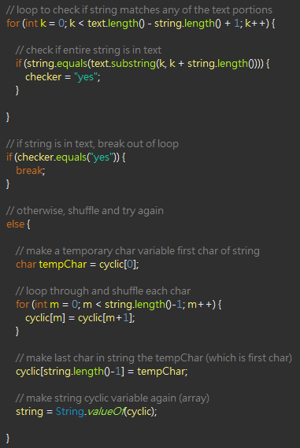
2) Check If String Is in Text
Use for loop to compare current string to the different text portions
Once comparisons is complete, if string is found in text, use “break;” function to break out of overlining for loop (seen in next slide)
If string is not found in text, shuffle the string
Similar to swapping 2 elements for sorting numbers in array except now for entire array

Slide 9
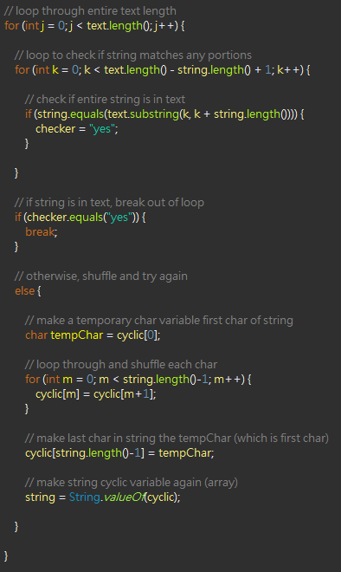
3) After Shuffle, Compare Again
Once comparison is done and no match is found, we want to shuffle chars and compare again
We want to make sure we shuffle and compare enough times to compare every shuffle possible
So place comparison code and shuffle into overlining for loop
After each comparison, we check if match is found and use “break;” function to break out of loop of comparing and shuffling

Slide 10
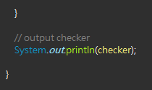
4) Display Output
Overlining for loop curly bracket
Display checker variable
Will display “no” automatically since it was initialized as this, otherwise will display “yes”
Remember to put it outside of overlining for loop but still inside main
Main curly bracket

Slide 11
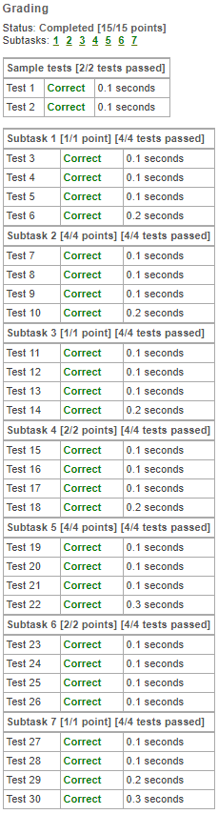
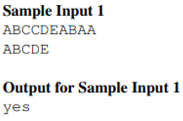

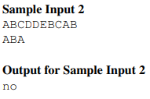


Test Your Solution

Slide 12
